Slide 1

Progressive Discipline
Notes:
Slide Show Notes
Today, we’re going to talk about progressive discipline. Progressive discipline is a method of applying discipline in steps, with the first offense meriting light correction and subsequent offenses receiving progressively harsher penalties. Typically, the discipline begins with a verbal warning and can progress to termination.

Slide 2


Session Objectives
Apply progressive discipline fairly and consistently
Identify laws and policy requirements
affecting discipline
Conduct effective disciplinary meetings
Document disciplinary action properly
Notes:
Slide Show Notes
The main objective of this session is to teach you the steps in progressive discipline and help you use this disciplinary system consistently and fairly to manage employee behavior and performance. By the time the session is over, you should be able to:
Apply progressive discipline fairly and consistently;
Identify laws and policy requirements affecting discipline;
Conduct effective disciplinary meetings; and
Document disciplinary action properly.

Slide 3


Prequiz:
How Much Do You Know?
Progressive discipline is a means
of not enforcing the rules.
Similar offenses under similar circumstances should be treated
the same way.
The first step in progressive discipline
is a written warning.
It is very important to document
disciplinary action.

Slide 4

Benefits of
Progressive Discipline
CONSISTENCY
PREDICTABILITY
Notes:
Slide Show Notes
Why is it important to know how to apply progressive discipline? Because the effective use of progressive discipline offers you, your employees, and the organization several significant benefits. Progressive discipline:
Establishes expectations and predictability;
Applies consequences fairly and consistently;
Corrects inappropriate behavior and poor performance;
Helps rehabilitate employees with potential; and
Protects against complaints and lawsuits.
Think about your experiences using progressive discipline and the benefits this process offered.
Ask trainees to share positive experiences with progressive discipline—cases where the process succeeded in improving behavior or performance and the worker turned out to be a valuable employee in the end.

Slide 5

Discipline and the Law
  EEO laws
  Consistency and fairness
  Retaliation
  Wrongful discharge
Notes:
Slide Show Notes
Let’s begin our discussion of progressive discipline with a look at some relevant legal issues.
State and federal equal employment opportunity laws prohibit discrimination in any aspect of employment, including disciplinary action. This means that you cannot discipline on the basis of an employee’s race, color, national origin, religion, age, sex, or disability.
The laws also require consistency and fairness in discipline. All similar offenses that occur under similar circumstances should be treated in the same way with the same discipline imposed. Discipline should be applied only in response to genuine violations of policy or work rules, or in response to genuinely poor performance. And discipline should always be appropriate to the offense.
Using discipline to retaliate against employees for filing claims or complaints, or for union activities, whistleblowing, and other similar protected activities, is illegal.
Employees who believe that they have been unfairly disciplined and have been terminated as a result can sue their employer for wrongful discharge. And if their lawsuit is successful, they may be awarded back pay, punitive damages, and attorney’s fees, all of which could add up to a lot of money.

Slide 6




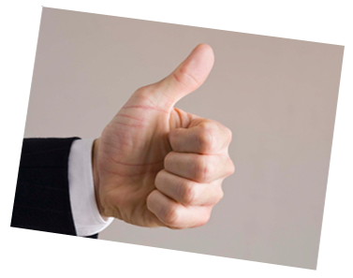



Discipline Policy
  Provides legal protection
  Gives structure
  Reassures
  Anticipates disciplinary problems
  Protects employees
  Gives an opportunity to improve
Notes:
Slide Show Notes
Discipline policies benefit and protect employees and employers.
The policy provides the organization with legal protection. It gives us the formula to document successive disciplinary actions and prove that those actions were appropriate and without bias.
The policy gives you a structure to follow when disciplining employees so that you can always apply discipline appropriately and productively.
The policy reassures the vast majority of employees who have no disciplinary problems that those who break the rules will be confronted.
The policy tries to anticipate and eliminate disciplinary problems by letting employees know that offenses will be punished and that steps will be taken to correct improper behavior and poor performance.
The policy also protects employees from the unsafe, inappropriate, offensive, or unethical actions of their co-workers.
And finally, it gives employees who violate the rules an opportunity to improve by letting them know what behavior and performance standards are required.
Are you familiar with your organization’s progressive discipline policy?
Review your organization’s progressive discipline policy.

Slide 7
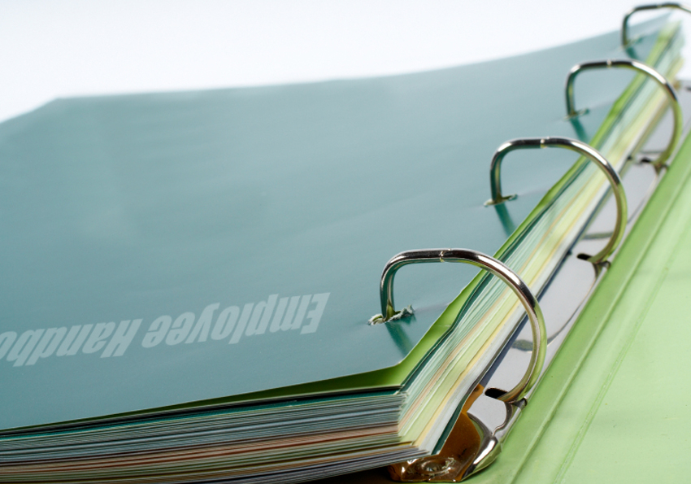
Employee Handbook
  Informs
  Advises
  Allows flexibility
  Informs
  Advises
  Allows flexibility
Notes:
Slide Show Notes
The employee handbook makes the progressive discipline policy known to employees.
The handbook informs employees of the terms of the organization’s discipline policy. No one can say that he or she didn’t know the rules.
The handbook also advises employees that the policy with be enforced when necessary, and it assures them that the policy will be enforced fairly and consistently.
Finally, the handbook statement allows some flexibility in the application of discipline by not being too specific about consequences. What we mean by this is that we don’t say that for
X offense, you will be given Y discipline, except in cases of extremely severe violations, such as violence or other criminal acts. By carefully phrasing our discipline statement in the handbook, we have some leeway in applying discipline and can take circumstances and mitigating factors into account when deciding appropriate disciplinary action.
Do you review this section in the handbook with all new employees? You should.
Discuss the discipline section in your employee handbook, and remind trainees to review it with all new employees.

Slide 8
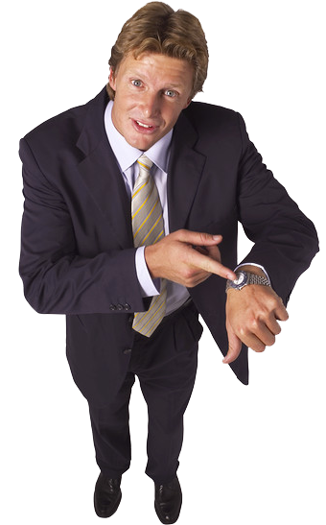

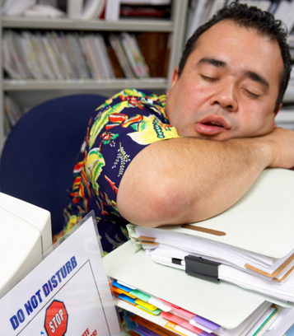
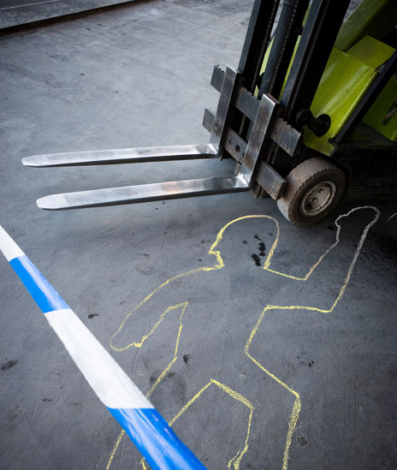
Common Discipline Problems
  Attendance
  Performance/behavior
  Safety
  Harassment
Notes:
Slide Show Notes
Now let’s look at some common discipline problems you may face on the job. You’re probably already familiar with most of these.
Chronic attendance problems and lateness are a frequent cause for discipline. And rightly so, since poor attendance and tardiness affect productivity and the morale of co-workers.
Poor performance and inappropriate or unacceptable behavior in the workplace are also common reasons for imposing progressive discipline.
Safety violations are another common cause for disciplinary action. Employees who take risks with their safety and the safety of co-workers must be corrected quickly to avoid an accident. Safety violations include rule infractions, carelessness, risk-taking, horseplay, and so on.
Harassment, whether sexual, racial, or ethnic, is another situation in which discipline is frequently required. Compliance with discrimination laws requires you to act swiftly and effectively in these cases, stop the harassment, and deal appropriately with the harasser.

Slide 9
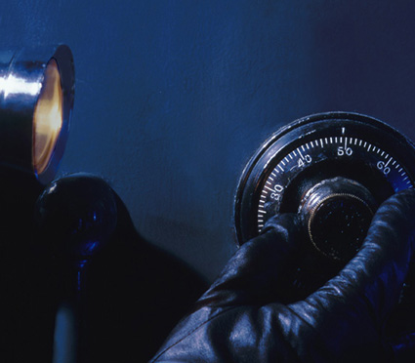



Common Discipline Problems (cont.)
  Equipment/materials
  Substance abuse
  Theft
  Violence/threats
Notes:
Slide Show Notes
Another common discipline problem is the abuse of equipment and materials. For example, an employee may repeatedly damage equipment or materials because of carelessness or inappropriate behavior, or use equipment without authorization.
Substance abuse on the job is another common disciplinary problem that must be dealt with promptly and effectively to protect the safety of co-workers and the employee in question.
Theft of the organization’s property or of co-workers’ property is another issue that requires disciplinary action. Depending on the situation, it might also involve criminal prosecution.
And finally, violence, or threats of violence, and fighting must be dealt with swiftly and decisively through the disciplinary process. Depending on the severity of the offense, disciplinary action might rise to the level of suspension or even termination.
Think about the discipline problems you have to handle most often. What strategies have you developed to anticipate and eliminate these problems at an early stage?
Discuss disciplinary problems trainees handle most often and the steps they take to manage these problems using progressive discipline.

Slide 10
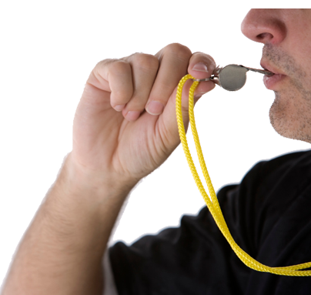
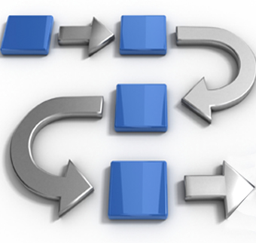


Consistency
  Address inappropriate behavior promptly
  Respond to violations immediately
  Follow policy
  Only discipline when necessary
Notes:
Slide Show Notes
In order to be fair and effective in managing employee behavior and performance, discipline must be applied consistently. Have you ever ignored minor rule violations or overlooked developing performance problems because you were busy or in no mood to deal with the issue?
All inappropriate behavior and poor performance should be addressed promptly, even if it’s only having a quiet word with the employee.
Respond to all rule violations immediately. If you delay, employees might get the wrong message and assume you don’t think the violation matters. Getting away with a small violations often leads to bigger problems. The same is true of declining performance. Address it immediately. Again, you don’t have to jump right to the discipline process if counseling the employee is sufficient to bring about change.
Always follow the progressive discipline policy when you decide that discipline is appropriate. Only skip steps in the process as prescribed by the policy.
And, only use discipline as a response to genuine violations. The same goes for performance issues. If somebody’s just having a bad day, using discipline would be inappropriate.

Slide 11


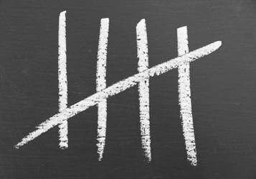
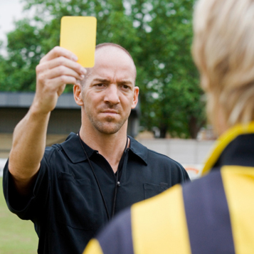
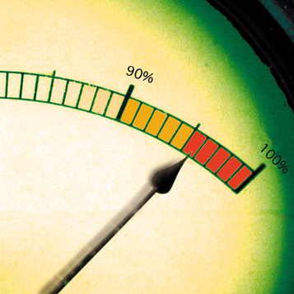


Consistency (cont.)
  Seriousness of the offense
  Number of offenses
  Consistency with previous actions
  Impact on employee morale
  Mitigating circumstances
  Prior conduct
Notes:
Slide Show Notes
Consistency in discipline also means treating all similar offenses in the same way. Don’t bend the rules for anyone. And never use discipline as an excuse to get revenge against someone.
Having said that, you should also take circumstances into account
and apply discipline that is appropriate to the offense. This means considering such things as:
The seriousness of the offense;
The number of offenses;
The consistency with previous disciplinary actions for similar offenses;
The impact on overall employee morale;
Any mitigating circumstances; and
The offender’s prior conduct, past performance record, length of service, and willingness and ability to correct the problem.
Remember, always give employees the opportunity to correct the problem. Use immediate suspension or discharge only for violations specified in the discipline policy and only after consulting with Human Resources.

Slide 12

Investigating Potential Disciplinary Cases
DOCUMENTATION
WITNESSES
FACTS
EXPLANATION
Notes:
Slide Show Notes
In some cases, before you apply progressive discipline, you may need to investigate the situation and make sure that discipline is actually required.
When this is the case, make sure you have all the facts. Review the offense or performance at issue and the circumstances. Don’t rely on hearsay, gossip, or subjective impressions. Obtain objective, corroborated information to back up your action.
Document your findings. This will also help support your ultimate decision and protect against employee complaints or legal action.
Give the employee a chance to explain. You need both sides of the story before making a disciplinary decision.
Also, if necessary, talk to others confidentially. For example, in the case of safety violations, harassment, or fights, you may need evidence from co-workers who witnessed or have information about the incidents.
Think about how you investigate situations that may involve discipline. Do you take these steps to ensure you make the right decision?
Ask trainees to talk about situations in which they investigated before applying discipline. Emphasize the need to have the facts and documentation to back up disciplinary actions.

Slide 13





Unscrambling Progressive Discipline
consistency
The law requires stciynsceno in the application of discipline.
Never use discipline to eelaritat against an employee.
One benefit of progressive discipline is that it helps employees with potential.
Poor nactadetne is a common disciplinary problem.
retaliate
rehabilitate
hbetearitali
attendance
Notes:
Slide Show Notes
Now it’s time for an exercise based on the information we’ve gone over so far. In each sentence on the screen there is a scrambled word related to progressive discipline. Your job is to unscramble the words and make sense of the sentences.
The law requires consistency in the application of discipline.
Never use discipline to retaliate against an employee.
One benefit of progressive discipline is that it helps rehabilitate employees with potential.
Poor attendance is a common disciplinary problem.
How did you do? Did you unscramble all the words correctly? Do you need to go back and review

Slide 14

Review
Do you understand:
  Benefits of progressive discipline?
  Statutory and policy requirements?
  Common discipline problems?
  Importance of consistency?
  Investigating potential disciplinary cases?
Notes:
Slide Show Notes
Now it’s time to ask yourself if you understand the information presented so far. For example, do you understand what we’ve said about:
Benefits of progressive discipline?
Statutory and policy requirements?
Common discipline problems?
The importance of consistency?
Investigating potential disciplinary cases?
It’s important to understand all this information so that you can be fair and consistent when applying progressive discipline and follow the law and the organization’s discipline policy.
Answer any questions trainees have about the information presented in the previous slides.
Conduct an exercise, if appropriate.
Let’s continue now to the next slide and talk about the steps in progressive discipline.

Slide 15

Progressive Discipline:
Four Essential Steps
WRITTEN WARNING
TERMINATION
VERBAL WARNING
SUSPENSION
Notes:
Slide Show Notes
One of the great advantages of progressive discipline is that it gives you the opportunity to proceed gradually. It gives you plenty of time, in most cases, to work with employees and try to correct behavior and improve job performance before having to resort to termination.
The four basic steps in progressive discipline are:
A formal verbal warning—as opposed to just raising an eyebrow or having a word with an employee;
A written warning that goes in the employee’s personnel file;
Suspension without pay; and
Termination.

Slide 16


Verbal Warnings
  Meet privately
  Give the employee
  a chance to explain
  Make sure it’s understood
  Formally issue the warning
  Create an action plan
Notes:
Slide Show Notes
We begin our examination of the steps in progressive discipline with verbal warnings.
When you give an verbal warning, meet privately with the employee and state the problem clearly.
Then, give the employee a chance to explain his or her side of the story. You can investigate any claims fully later, if necessary. But at this point, just listen without interrupting. If there are issues that need investigation, you can suspend the meeting at this point and resume once you have the facts.
Otherwise, continue, making sure the employee understands the rule and its purpose, or the performance issue and the required standard.
Formally issue the warning, and explain the next step in the disciplinary process—a written warning—if the behavior is not corrected or the performance does not improve.
And finally, agree on an action plan to correct the problem. Make sure the employee understands and is onboard with what needs to be done.
Do you follow this procedure when you give verbal warnings?
Have two volunteers role-play a verbal warning to an employee who has been coming in late. Have the group critique the “supervisor’s” performance.

Slide 17


Written Warnings
  Reserved for repeated or serious violations
  Get approval from HR
  Work out an action plan
  Sign the form
  Give a copy
Notes:
Slide Show Notes
The next step in the progressive discipline process is the written warning.
Written warnings are generally reserved for repeated or serious rule violations, or significant performance problems that have not improved following a verbal warning and show no hopeful signs of improving anytime soon.
Be sure to get approval and the required forms from HR before issuing a written warning. Fill out the warning form objectively, giving a clear explanation of the specific rules violated, along with the date, time, place, and other facts. For performance problems, state the standards that have not been met and cite specific instances.
When issuing a written warning, just as when giving a verbal warning, work out a corrective action plan with the employee, and attach it to the written warning form. Your action plan should include a timetable for improvement.
Sign, and have the employee sign, the warning form. Should the employee refuse to sign, note that on the form with a comment such as, “Reviewed with employee, who refused to sign.”
Finally, give the employee a copy of the warning and action plan, and keep a copy for yourself. The original goes in the employee’s personnel file.
Make sure you’re familiar with the organization’s procedures for giving written warnings and for completing the warning form.
Have trainees fill out a written warning form for an employee who has used harassing language to another employee. Have employees read the results and discuss.

Slide 18


Suspension
  Consult HR
  Meet with employee
  Sign forms
  Meet after suspension
  Follow up
Notes:
Slide Show Notes
Suspension without pay is the next step if an employee still does not improve after a written warning. It’s the last resort before termination, and the employee should fully realize this. The hope is that a suspension will cause an employee to recognize the seriousness of the problem and commit to change.
Before suspending an employee, consult HR and decide together the appropriate length of the suspension under the circumstances. Three days is typical, but you may decide on more or less.
Have another supervisor or an HR representative present when you meet with an employee to issue a suspension. Explain the problem, its seriousness, and the purpose and length of the suspension.
Sign and have the employee sign the appropriate forms.
Meet with the employee again at the end of the suspension period to agree to any further corrective action. Document this meeting and all subsequent meetings on forms signed by you and the employee.
Follow up on any agreed-on corrective action to make sure that the employee is complying with your agreement.

Slide 19


Termination
  Usually a last resort
  Could be a first step
  Consult with HR
  Have someone present
Notes:
Slide Show Notes
If all the other steps in the progressive discipline process fail to turn an employee around, this is the time to consider termination. But remember, in order to protect against charges of wrongful discharge, this final step must be handled with extreme caution and attention to all the details.
In rare cases, termination may be used as a first resort—for example, for violence, gross insubordination, highly dangerous behavior, or theft or other criminal behavior. Situations like these might justify skipping directly to termination. But in most cases, termination is a last resort.
Consult with HR and investigate all the facts carefully. Then work with HR to follow all required termination procedures under the organization’s termination policy. Assemble documentation that can stand up to a legal challenge, and prepare the necessary paperwork.
Have another supervisor or HR rep present when you meet with the employee. Explain the reason for termination and the procedures that will be followed. Be sure to document the meeting in a report.
Are you familiar with the organization’s termination policy and procedures? You should be.
Review your organization’s termination policy and procedures.

Slide 20

Disciplinary Meetings
  Review the personnel file
  Consider the seriousness of the violation
  Review policies
  Examine similar situations
  Identify mitigating circumstances
Notes:
Slide Show Notes
We’ve already covered some of the guidelines for disciplinary meetings in the course of discussing the progressive discipline steps. Now let’s review and look at this important interaction more closely. Try to determine the core facts of the case before the meeting.
Review the employee’s personnel file;
Consider the seriousness of the rule violation or performance problem, as well as the employee’s past record;
Review policies to see how this problem should be addressed;
Determine how you and other supervisors have handled similar situations in the past; and
Identify any mitigating circumstances—for example, personal problems, provocation by co-workers, circumstances outside the employee’s control, and so forth.
Meet privately with the employee promptly after the offense or at the first signs of a performance problem. Counseling or at most a brief informal caution or warning might be adequate for minor problems and for cooperative employees. In other cases, the meeting may be part of the progressive discipline process.

Slide 21

Disciplinary Meetings (cont.)
  Be calm and objective
  Let employee explain
  Emphasize seriousness
Notes:
Slide Show Notes
Be calm and objective during these meetings. Don’t argue, get angry, lecture, or interrogate. Focus on the employee’s behavior
or performance and its potential consequences rather than on personality issues.
Give the employee the opportunity to explain. Keep an open mind, listen without interrupting, and don’t pass judgment until you’ve heard the whole story. There might be a reasonable explanation for the problem, such as lack of training, inadequate knowledge or understanding, or circumstances beyond the employee’s control.
During the meeting, emphasize the importance of the meeting and the issue under discussion. Restate the problem and explain clearly what you want corrected.

Slide 22

Disciplinary Meetings (cont.)
DOCUMENT MEETING
AGREE ON ACTION PLAN
DECIDE ON DISCIPLINE
FOLLOW UP
Notes:
Slide Show Notes
Determine the best form of discipline for preventing a repeat of the problem. Keep the emphasis on correction, not punishment. Make sure your choice is consistent with discipline for similar offenses in the past.
If you are issuing a formal warning, do so at this point. Then, mutually agree on a plan of corrective action. Ask the employee to suggest a plan, if appropriate, or create the plan together. Be sure you are both in agreement about what needs to be done, and by when.
Be sure to document the meeting. Take brief notes during the meeting and date them. Then, as soon after the meeting as possible, turn your notes into a formal dated report. Place your meeting notes along with the report into the employee’s personnel file.
After the meeting, follow up to see if the employee is following the action plan. Provide encouragement and support to an employee who is clearly trying to change. Give additional warnings to an employee who is not making the effort to improve.
Think about how you should handle disciplinary meetings to get the best results.
Review your organization’s policy on disciplinary meetings.

Slide 23

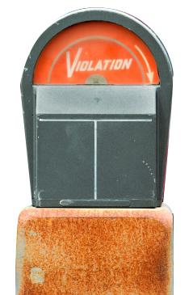



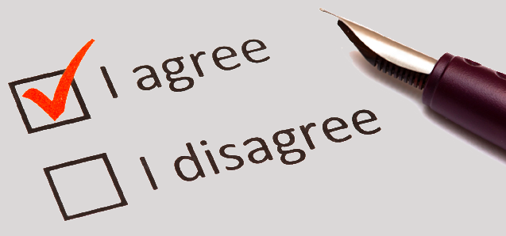
Documenting Discipline
  Date/time
  Facts
  Rules/standards
  Action taken
  Remediation
  Signatures
© Business & Legal Reports, Inc. 1007
Notes:
Slide Show Notes
We’ve spoken about documentation throughout the session, but we cannot overemphasize its importance in the disciplinary process. Objective, complete documentation is essential in preventing successful legal actions against the organization.
Documentation of disciplinary action should include:
Date, time, and place of infractions or specific instances where performance was substandard;
Factual details about behavior or performance problems;
Specific rules violated or standards not met;
Formal disciplinary action taken;
Remedial steps recommended and agreed on for correcting the problem and avoiding future problems; and
Your signature and the employee’s signature.
Discipline records should be kept on file for the period mandated by your discipline policy.
Think about how you document disciplinary action. Do you include all this information?
Review your organization’s requirements for documenting discipline.

Slide 24

Put the progressive discipline steps
in their proper order?
Termination
Suspension
Written warning
Verbal warning
Notes:
Slide Show Notes
Now let’s see if you remember the proper order of the steps in progressive discipline. Review the four steps you see on the screen
and think about what the proper order is. [PAUSE]
OK, here is the proper order:
1. Verbal warning,
2. Written warning,
3. Suspension, and
4. Termination.
Of course, in rare cases, you may be authorized to skip steps because of the seriousness of the offense. But generally, you should always begin with the least severe penalty and proceed through the steps to the ultimate disciplinary action—termination.

Slide 25

Review
Do you understand:
  Progressive discipline steps?
  Disciplinary meetings?
  Documenting discipline?
Notes:
Slide Show Notes
Let’s take a moment to review. Do you understand what we’ve said in the previous slides about:
The progressive discipline steps?
How to conduct disciplinary meetings?
Requirements for documenting discipline?
It’s important to understand this information so that you can discipline employees properly when necessary and achieve the most positive results.
Answer any questions trainees have about the information presented in the previous slides.
Conduct an exercise, if appropriate.
Now let’s continue to the last slide and some key points to remember about the session.

Slide 26


Key Point to Remember
The steps in progressive discipline are
verbal warning, written warning, suspension, and termination.
Be consistent when applying discipline.
Help employees correct problems.
Document all disciplinary action.
Notes:
Slide Show Notes
Here are the key points to remember from this training session on progressive discipline:
The steps in progressive discipline are verbal warning, written warning, suspension, and termination.
Be consistent when applying discipline and always follow your organization’s policy.
Help employees correct problems.
Protect yourself and the organization by documenting all disciplinary action.
This concludes the Progressive Discipline training session.
Give trainees the quiz, if appropriate.

